Slide 1
Data Structures
Makefile – Introduction

Slide 2
Makefile

Slide 3
Data Structure – Makefile
Introduction
Why Makefile?
What is Makefile?
Implementation

Slide 4
Data Structure – Makefile
Introduction

Slide 5
Data Structure – Makefile
Introduction
1.c
a.out

Slide 6
Data Structure – Makefile
Introduction
1.c
a.out
Different Stages of Compliation
Preprocessor
Compiler
Assembler
Linker
Loader

Slide 7
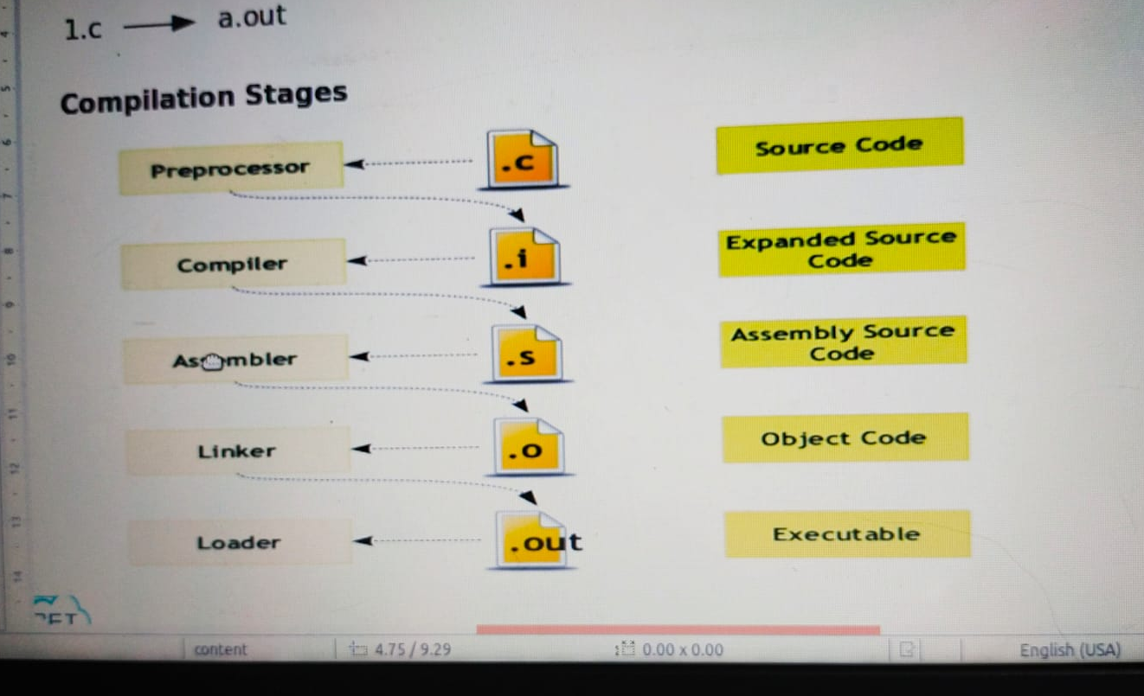

Slide 8
Data Structure – Makefile
Introduction
1.c
a.out
1.c
2.c
3.c

Slide 9
Data Structure – Makefile
Introduction
1.c
a.out
1.c
2.c
3.c
1.o
2.o
3.o
a.out

Slide 10
Data Structure – Makefile
Introduction
Why?
Project
1000 source file

Slide 11
Data Structure – Makefile
Introduction
Why?
Project
1000 source file
gcc <all source files>
gcc *.c

Slide 12
Data Structure – Makefile
Introduction
What?
Makefiles are simple ways to organize code compilation
A makefile is a file containing a set of directives used by a make build automation tool to generate a target/goal.
Name
Makefile
makefile
My_makefile
A makefile is executed using make command
make -f <MY_makefile>

Slide 13
Data Structure – Makefile
Introduction
Rule
Target : Dependencies
<Tab> reciepe
Sub Target: Dependencies
<Tab> reciepe
clean:
<Tab>reciepe

Slide 14
Data Structure – Makefile
Introduction
main.c
add.c
mul.c
sub.c
Rule
Target : Dependencies
<Tab> reciepe
Sub Target: Dependencies
<Tab> reciepe
clean:
<Tab>reciepe

Slide 15
Data Structure – Makefile
Introduction
main.c
add.c
mul.c
sub.c
Rule
Target : Dependencies
<Tab> reciepe
Sub Target: Dependencies
<Tab> reciepe
clean:
<Tab>reciepe
main.o
add.o
mul.o
sub.o

Slide 16
Data Structure – Makefile
Introduction
main.c
add.c
mul.c
sub.c
Rule
Target : Dependencies
<Tab> reciepe
Sub Target: Dependencies
<Tab> reciepe
clean:
<Tab>reciepe
main.o
add.o
mul.o
sub.o
calc.exe

Slide 17
Rule
main.c
add.c
mul.c
sub.c
Target : Dependencies
<Tab> reciepe
Sub Target: Dependencies
<Tab> reciepe
clean:
<Tab>reciepe
main.o
add.o
mul.o
sub.o
calc.exe
calc.exe : main.o add.o mul.o sub.o
<tab>gcc -o calc.exe main.o add.o mul.o sub.o
main.o : main.c
<tab> gcc -c main.c
add.o : add.c
<tab> gcc -c add.c
mul.o : mul.c
<tab> gcc -c mul.c
sub.o : sub.c
<tab> gcc -c sub.c
Clean:
<tab> rm *.exe *.o
Alternative method
OBJ := $(patsubst %.c ,%.o,$(wildcard *.c))
calc.exe : $(OBJ)
<tab>gcc -o $@ $^
Clean :
<tab> rm *.exe *.o

Slide 18
Makefile -Implementation

Slide 19
Data Structure – Makefile
Introduction
main.c
add.c
mul.c
sub.c
Rule
Target : Dependencies
<Tab> reciepe
Sub Target: Dependencies
<Tab> reciepe
clean:
<Tab>reciepe
main.o
add.o
mul.o
sub.o
calc.exe
calc.exe : main.o add.o mul.o sub.o
<Tab>gcc -o calc.exe main.o add.o mul.o sub.o
main.o: main.c
<Tab>gcc -c main.c
add.o: add.c
<Tab>gcc -c add.c
sub.o: sub.c
<Tab>gcc -c sub.c
clean:
<Tab>rm *.exe *.o

Slide 20
Data Structure – Makefile
Introduction
main.c
add.c
mul.c
sub.c
Rule
Target : Dependencies
<Tab> reciepe
Sub Target: Dependencies
<Tab> reciepe
clean:
<Tab>reciepe
main.o
add.o
mul.o
sub.o
calc.exe
calc.exe : main.o add.o mul.o sub.o
<Tab>gcc -o calc.exe main.o add.o mul.o sub.o
main.o: main.c
<Tab>gcc -c main.c
add.o: add.c
<Tab>gcc -c add.c
sub.o: sub.c
<Tab>gcc -c sub.c
clean:
<Tab>rm *.exe *.o

Slide 21
Data Structure – Makefile
Introduction
main.c
add.c
mul.c
sub.c
Rule
Target : Dependencies
<Tab> reciepe
Sub Target: Dependencies
<Tab> reciepe
clean:
<Tab>reciepe
main.o
add.o
mul.o
sub.o
calc.exe
calc.exe : main.o add.o mul.o sub.o
<Tab>gcc -o calc.exe main.o add.o mul.o sub.o
main.o: main.c
<Tab>gcc -c main.c
add.o: add.c
<Tab>gcc -c add.c
sub.o: sub.c
<Tab>gcc -c sub.c
clean:
<Tab>rm *.exe *.o
Alternate
OBJ := $(patsubst %.c, %.o, $(wildcard *.c))
calc.exe: $(OBJ)
<Tab> gcc -o $@ $^
clean:
<Tab> rm *.exe *.o

Slide 22
Data Structure – Makefile
Introduction
Advantages
The compilation is done using single command ie make
Re compiles only what is needed when you make a change
Make keeps track of time

Slide 23
Time Complexity

